Slide 1


Parallel Programming
Faculty of Electronics, Telecommunications and Information Technology
On embedded multi-core
System ESP32
Teachers:
Aurel GONTEAN
Alexandru SFIRAT
Students:
Marian-Claudiu BELEAN
Franz Joseph PAL

Slide 2
Content
i. Introduction
ii. Problem definition
iii. Basic Concept of Parallel Programming
iv. Parallel Programming Architecture

Slide 3
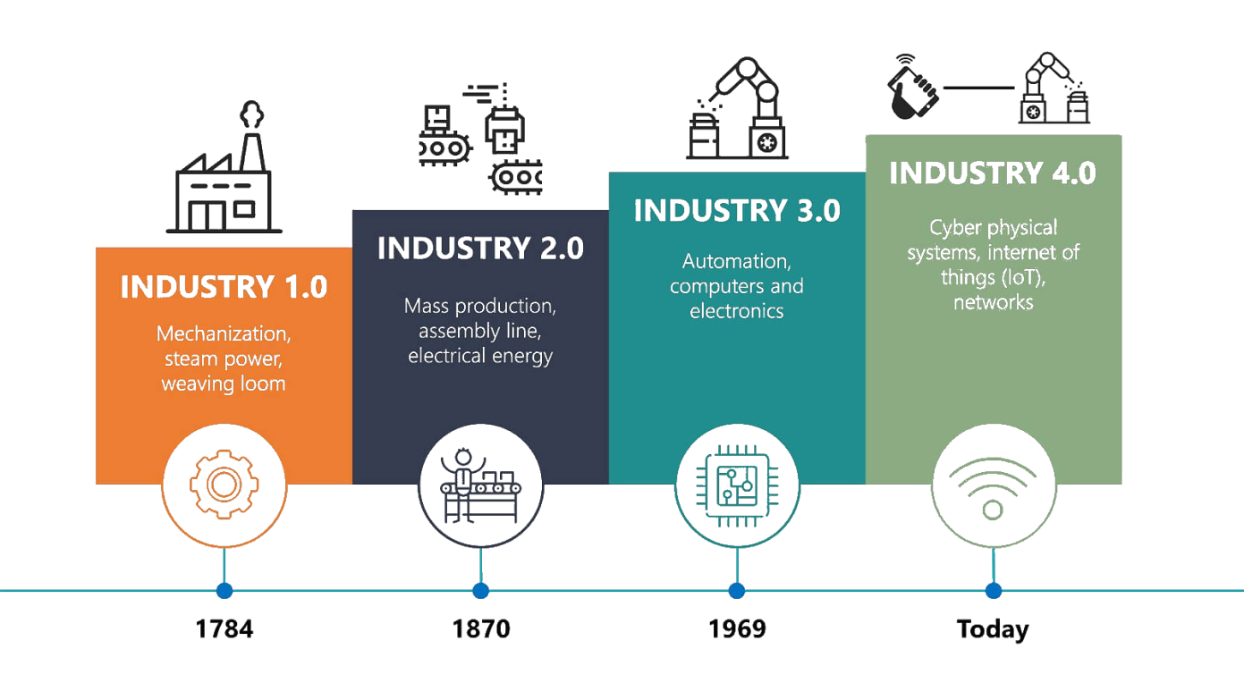
Introduction
Multicore Systems are becoming increasingly popular as part of digitalization and Industry 4.0 important role in data processing and process automation

Slide 4
Problem Definition
ESP32

